Slide 1
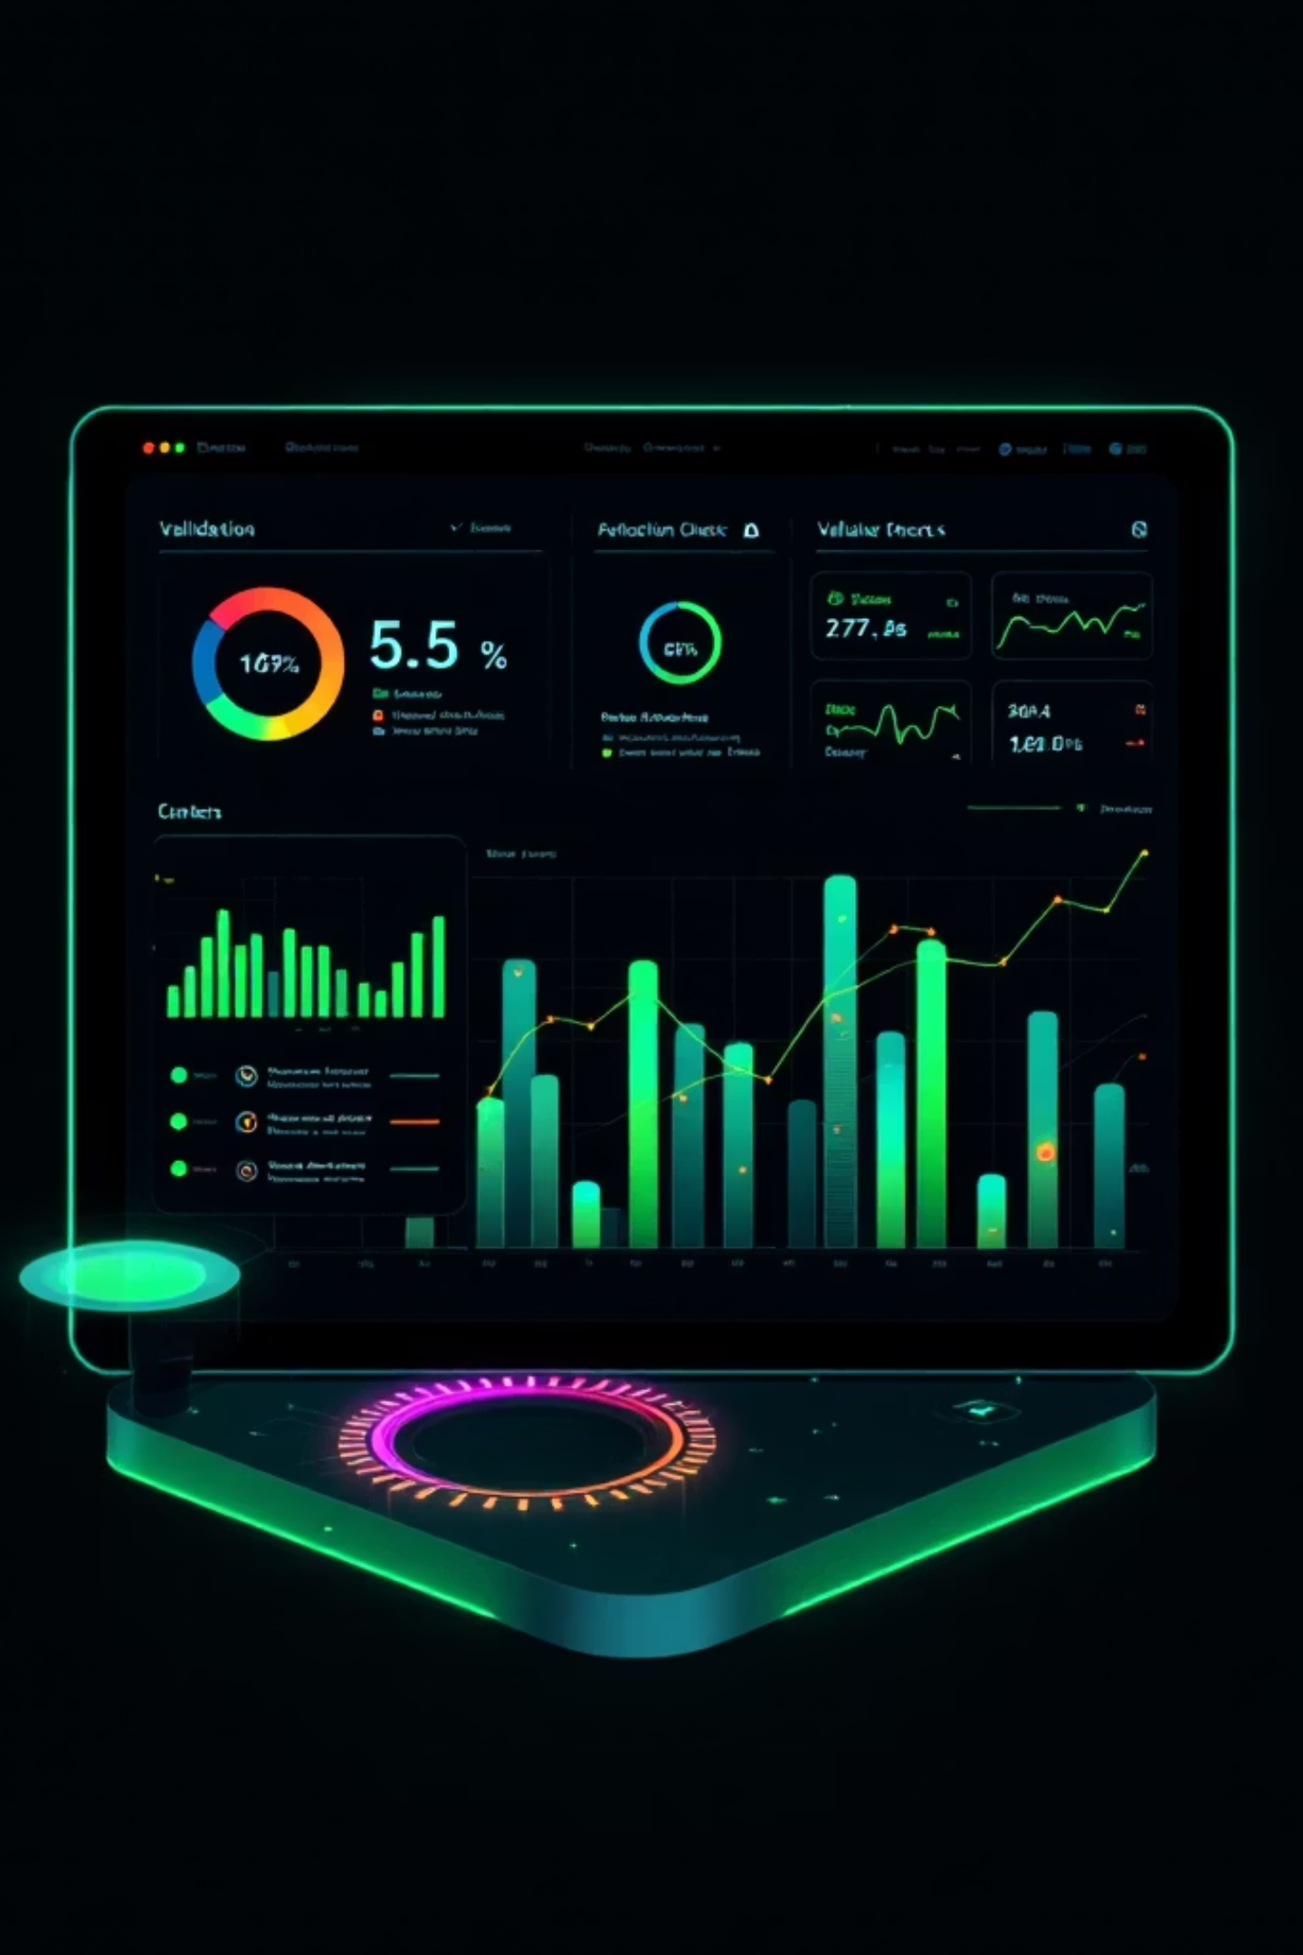
AdmitGuard
A Rule-Driven Eligibility Governance System for Higher Education Admissions

Slide 2


The Real-Life Problem
In most admission workflows today, candidate data is captured in Excel or Google Sheets by sales or operations teams. There is no validation at the point of entry, even though eligibility rules for IITs and similar institutions are complex and program-specific.
What Happens in Practice
Ineligible candidates move forward silently through the pipeline
They reach interview or document verification stages only to be rejected
Counselor and interview panel time is already spent
Candidate expectations are already set, creating disappointment
Compliance risk increases with institutional partners
The Core Issue: Late detection of ineligibility combined with ungoverned exception decisions creates operational inefficiency and compliance exposure.

Slide 3
Design Approach
This was approached as a governance problem, not just a validation problem. The focus was on early enforcement and operational clarity.
01
02
03
Early Enforcement
Rule Separation
Governed Flexibility
Separate rules into strict vs soft categories to balance enforcement with flexibility
Catch eligibility issues at the moment data is entered, preventing downstream waste
Allow exceptions only with accountability through structured justification
04
05
Configurable Rules
Lightweight Design
Make rules configurable because eligibility criteria change across programs and time
Keep the system lightweight and deployable without heavy backend infrastructure

Slide 4

Key Components of AdmitGuard
Form-Based Entry
Strict vs Soft Rules
Controlled form with real-time validation. Strict rules block progress immediately. Errors are human-readable, not technical.
Strict rules completely block submission. Soft rules allow overrides only with professional justification.
Exception Handling
Rules Console
Each violation requires rationale with enforced quality. Exception count tracked per candidate. Auto-flag excessive exceptions.
Update thresholds without touching code. Changes apply only to future evaluations. Past audit records remain untouched.
Audit Dashboard
Export Capability
Every evaluation logged with timestamp and outcome. Shows total evaluations, eligibility status, exception usage, and review load.
Full candidate data, decisions, and exceptions exportable as CSV or JSON for ops review or compliance checks.

Slide 5
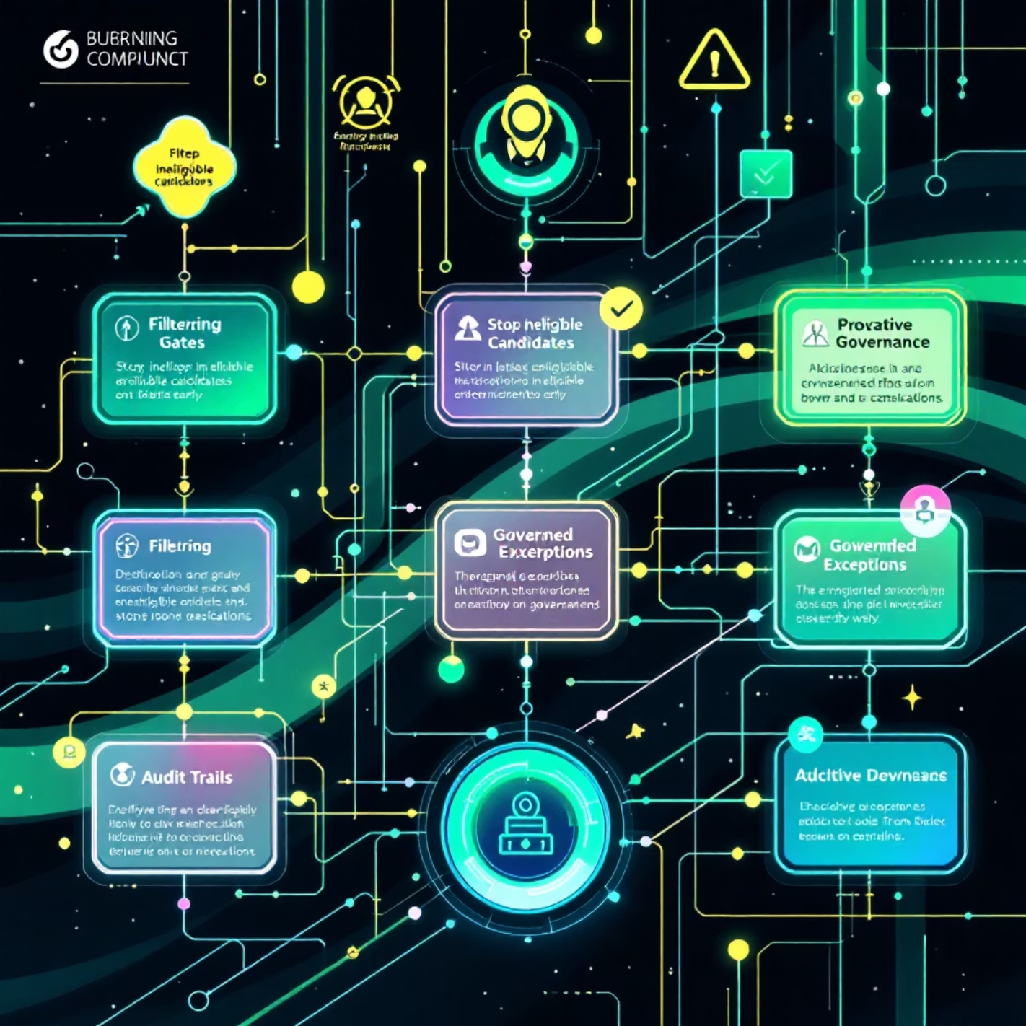
Operational Impact
What Changes Operationally
Ineligible candidates stopped before interviews, saving valuable time
Exceptions become governed decisions, not informal approvals
Ops teams can update rules safely as criteria change
Management gets visibility into exception usage patterns
Audit and compliance risks are systematically reduced
The system shifts from reactive correction to proactive governance — ensuring rules are enforced early, exceptions are transparent, decisions are auditable, and operations remain flexible.

Slide 6
Live Demo
Eligibility Form
Enter candidate details. Show strict rule block (e.g., rejected interview). Show soft rule violation triggering exception toggle.
Exception Governance
Enable exception. Enter rationale. Show exception count and status indicator with quality enforcement.
Evaluation Result
Show final eligibility status with highlighted exceptions applied and rationale captured.
Audit Log & Dashboard
Show logged entry with timestamp. Point out dashboard metrics on eligibility distribution and exception usage.
Rules Configuration
Change threshold value. Show how it immediately affects validation for future entries.

Slide 7

Key Takeaways
Not Replacing Judgment
The goal is to govern human judgment, not replace it — ensuring decisions are informed and transparent
Early Enforcement
Rules are enforced at point of entry, preventing downstream waste and late-stage rejection
Transparent Exceptions
Every override requires professional rationale, creating accountability and audit trail
Auditable Decisions
Complete logging of every evaluation with timestamp, outcome, and justification captured
Preventing wasted effort through early, governed enforcement — that's the biggest value AdmitGuard delivers to FLC operations and governance.

Slide 8


